Slide 1
1

Slide 2

APPLIED CRYPTOGRAPHY
Lecture 44
2

Slide 3
Security protocol
SSL and TLS
3

Slide 4
Contents
To discuss the need for security services at the transport layer of the Internet model
To discuss the general architecture of SSL
To discuss the general architecture of TLS
To compare SSL and TLS

Slide 5
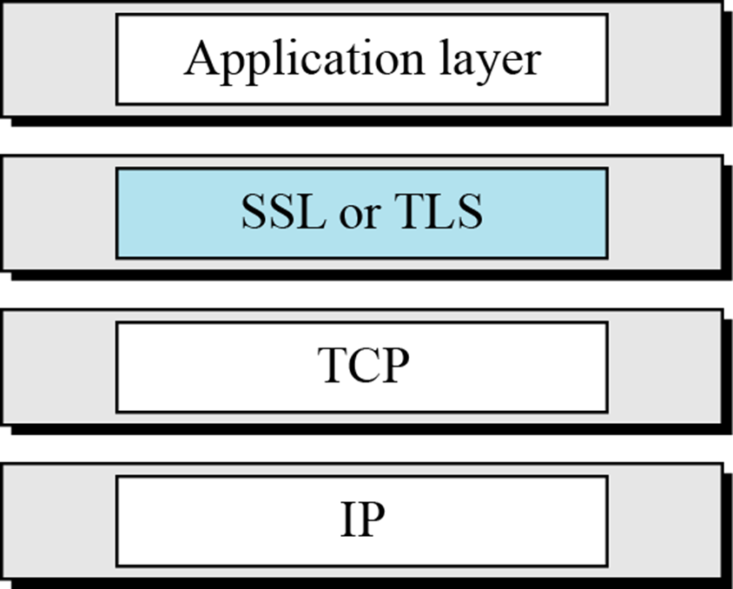
Location of SSL and TLS in the Internet model

Slide 6
SSL ARCHITECTURE
SSL is designed to provide security and compression services to data generated from the application layer.
Services include
Fragmentation
Compression
Message Integrity
Confidentiality
Framing

Slide 7
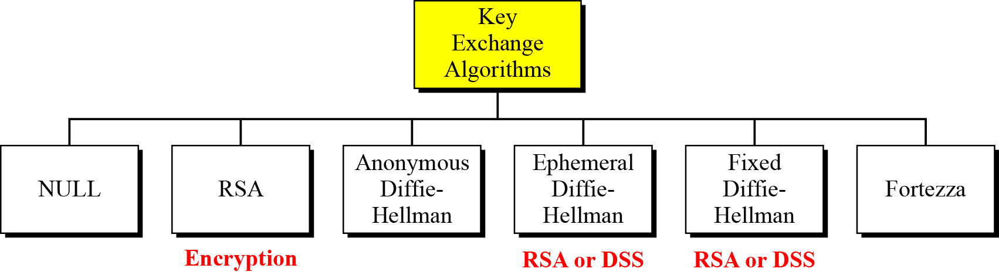
Key Exchange Algorithms

Slide 8
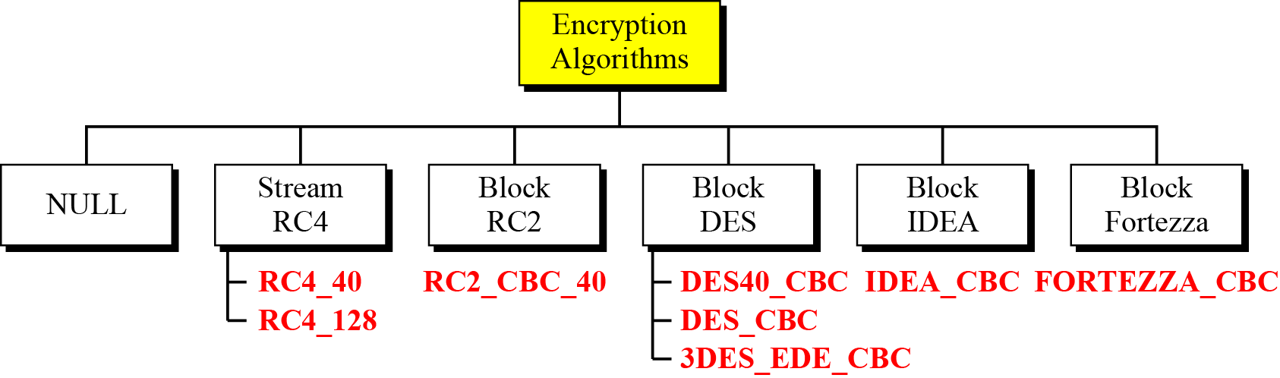
Encryption / decryption

Slide 9
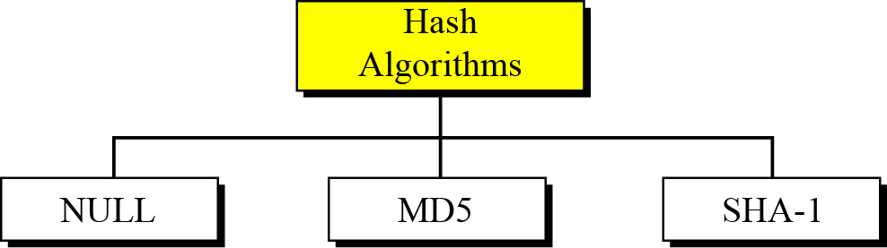
Message Integrity (Hash Algorithm)

Slide 10
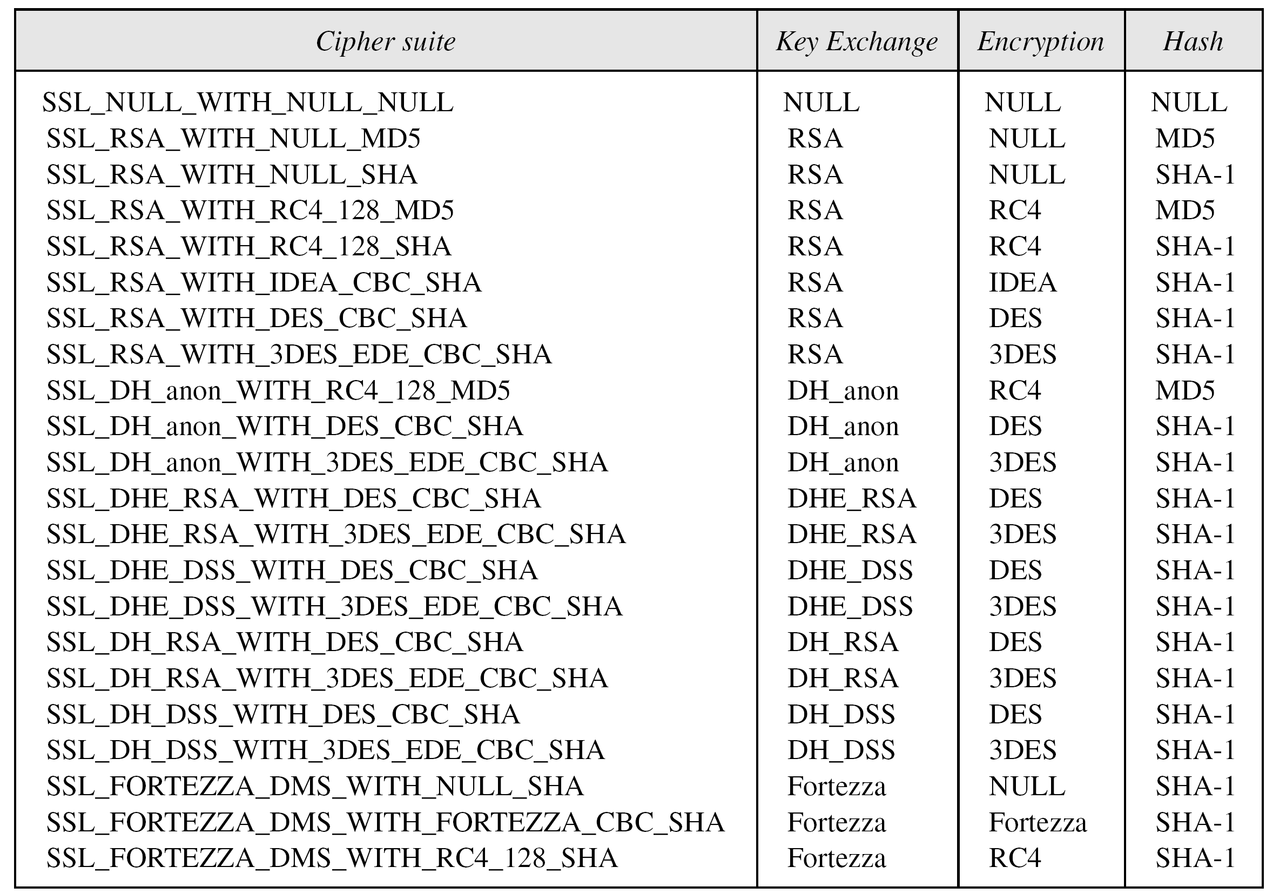
SSL cipher suite list

Slide 11
Compression Algorithm
Compression is optional in SSLv3. No specific compression algorithm is defined for SSLv3. Therefore, the default compression method is NULL

Slide 12
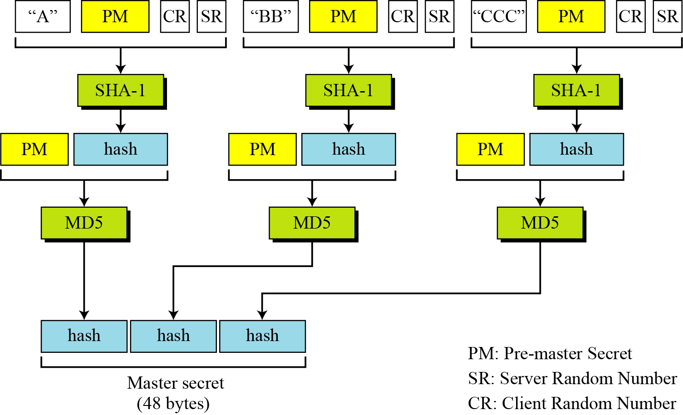
Calculation of master secret from pre-master secret

Slide 13
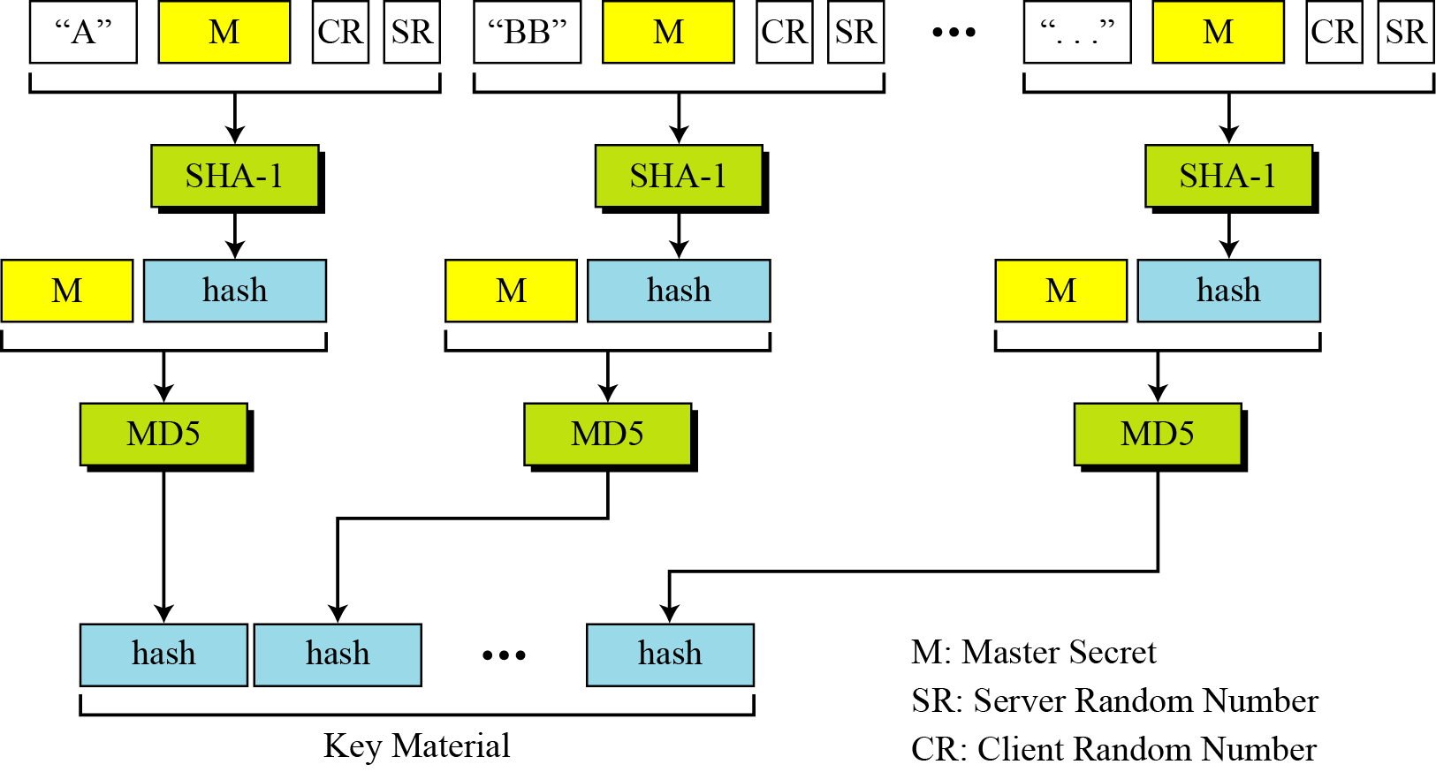
Calculation of key material from master secret

Slide 14
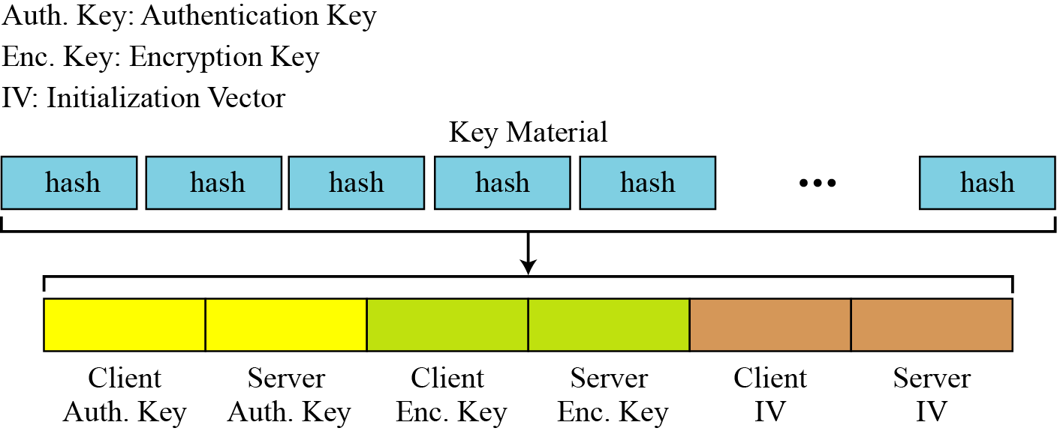
Extractions of cryptographic secrets from key material

Slide 15
Sessions and Connections
In a session, one party has the role of a client and the other the role of a server;
In a connection, both parties have equal roles, they are peers.

Slide 16
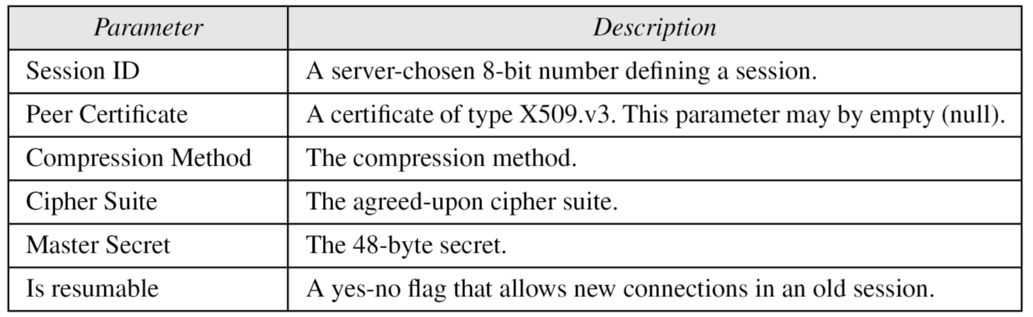
Session state parameters

Slide 17
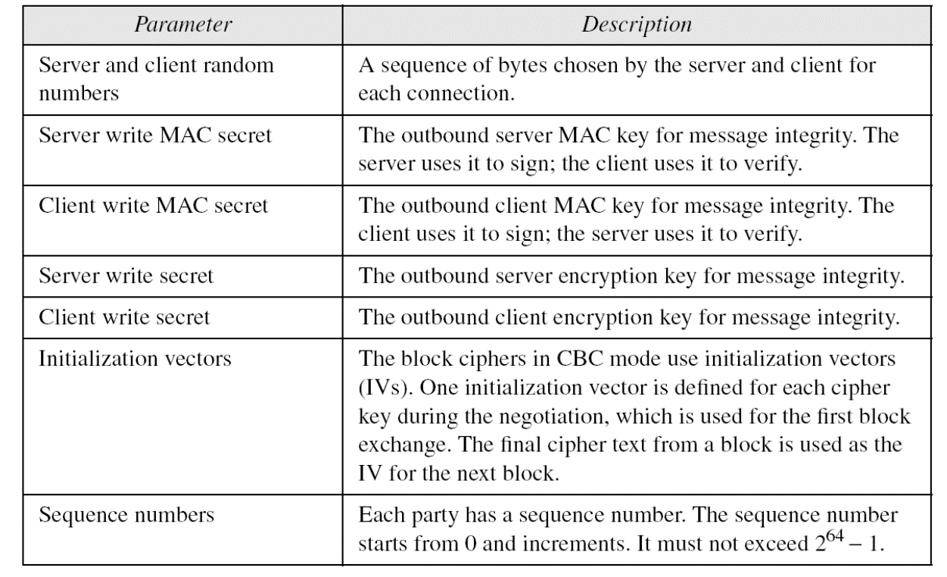
Connection state parameters

Slide 18
The client and the server have six different cryptography secrets: three read secrets and three write secrets.
The read secrets for the client are the same as the write secrets for the server and vice versa.

Slide 19
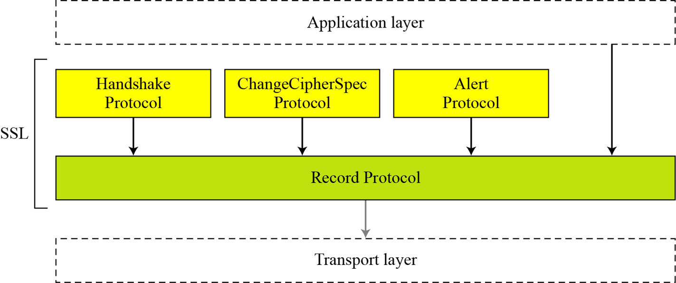
Four SSL protocols

Slide 20
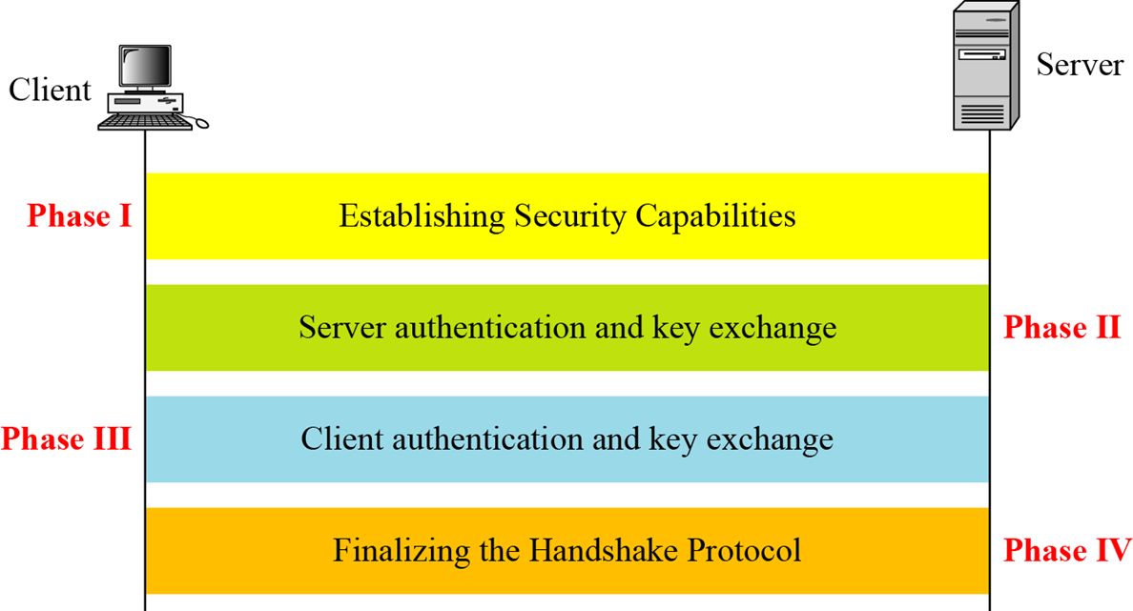
Handshake Protocol

Slide 21
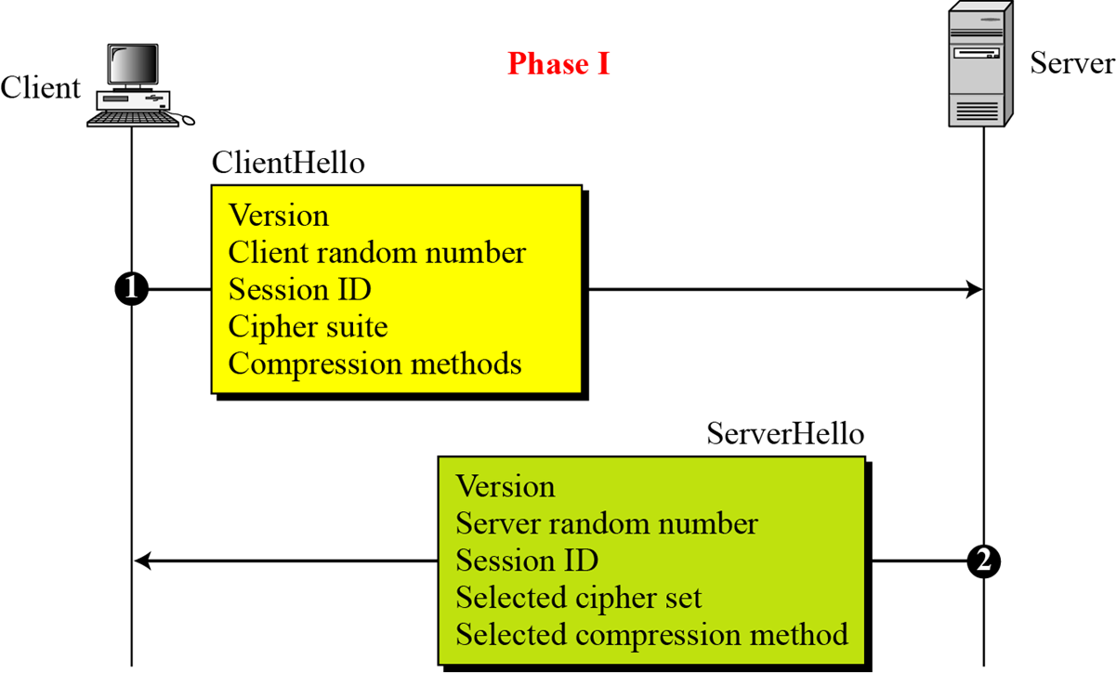
Phase I of Handshake Protocol

Slide 22
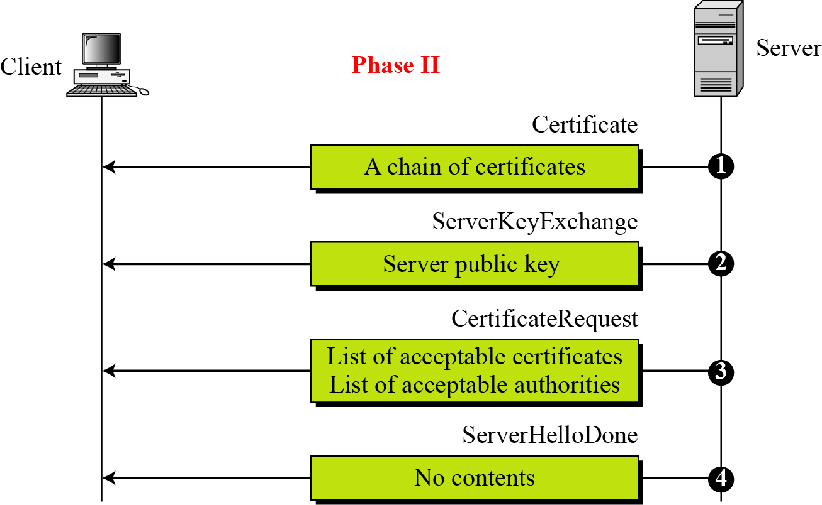
Phase II of Handshake Protocol

Slide 23
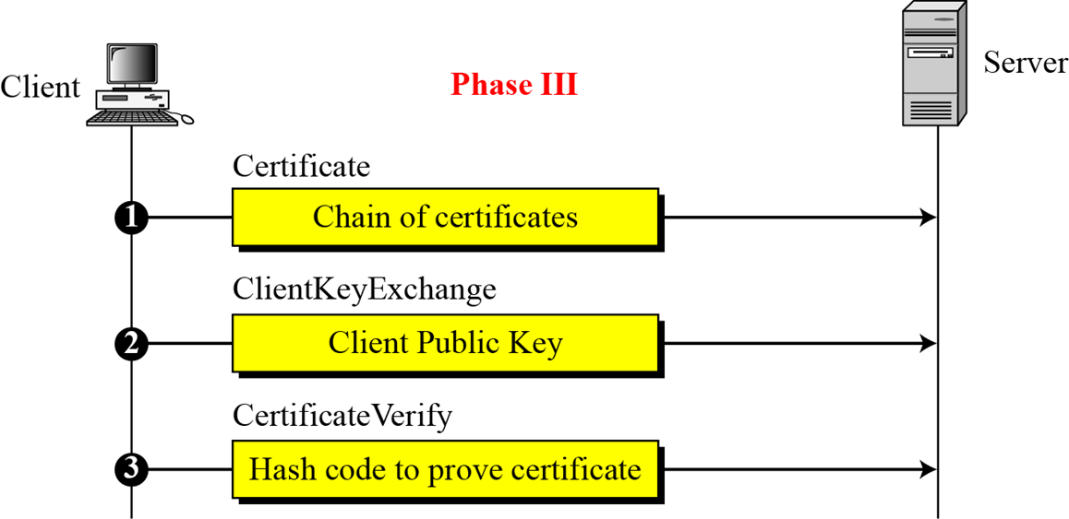
Phase III of Handshake Protocol

Slide 24
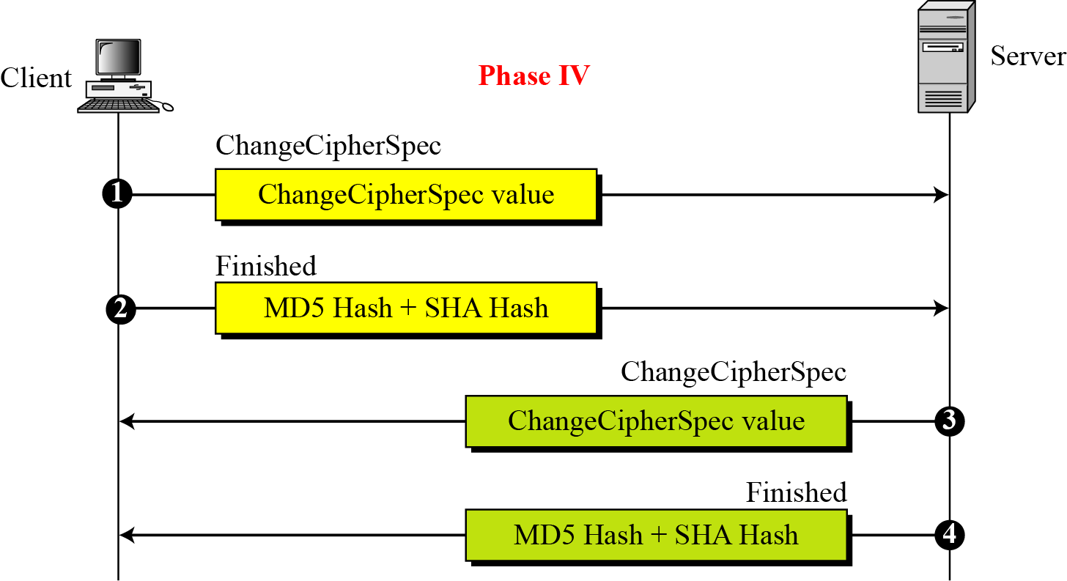
Phase IV of Handshake Protocol

Slide 25
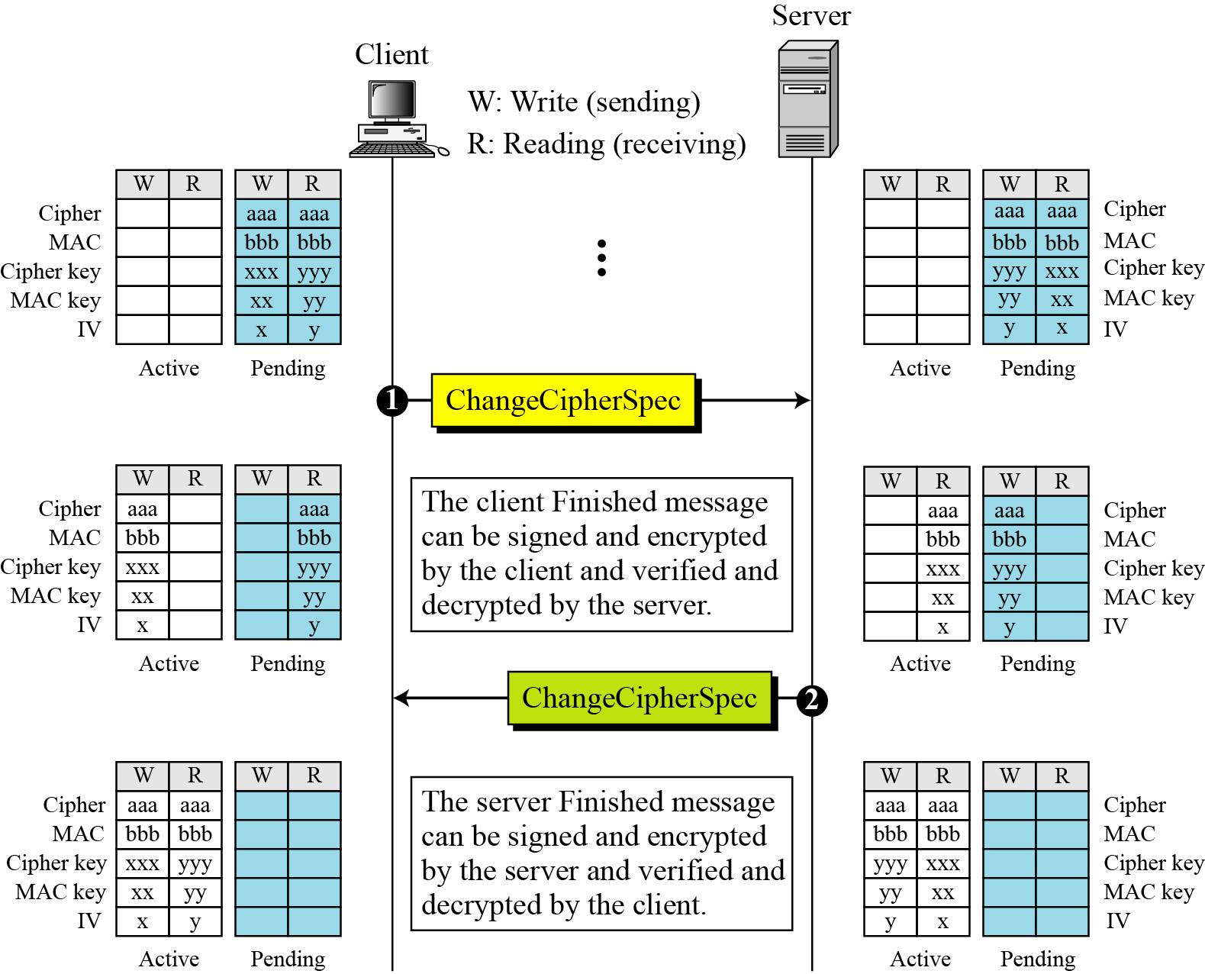
After Phase IV, the client and server are ready to exchange data.

Slide 26
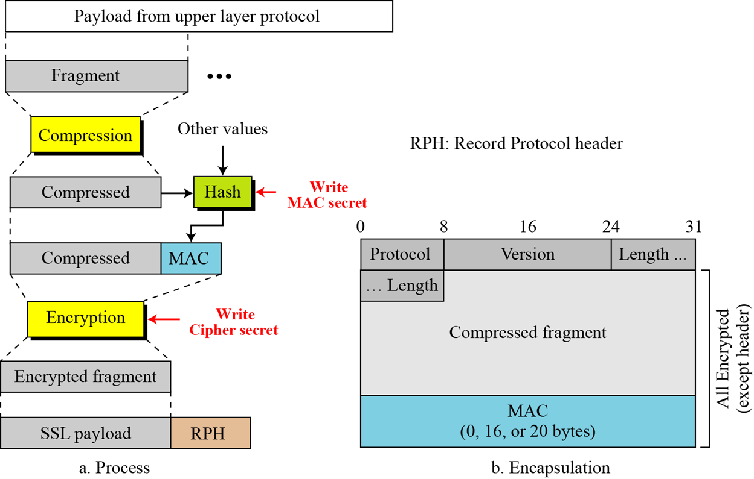
Record Protocol

Slide 27
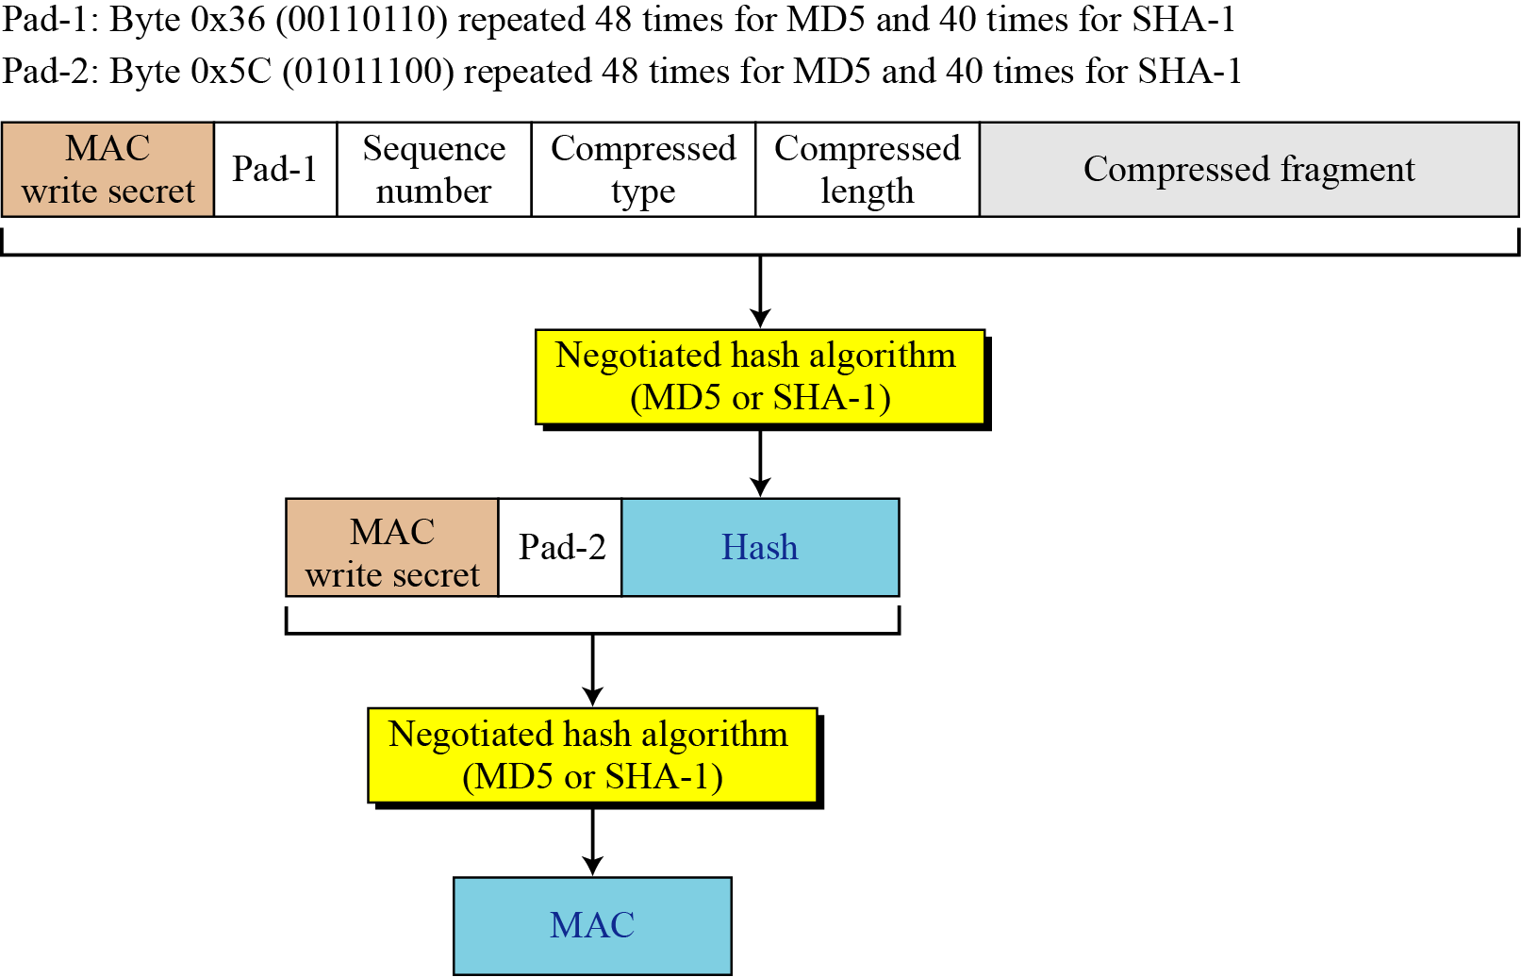
Calculation of MAC

Slide 28
Thank You!
Next Class
Mandatory reading for the next class
RFC 5246 - The Transport Layer Security (TLS) Protocol Version 1.2
RFC 4346 - The Transport Layer Security (TLS) Protocol Version 1.1
RFC 2246 - The TLS Protocol Version 1.0
28

Slide 29


Rajashree S
Computer Science and Engineering
PES University, Bengaluru
10 June 2020
29

